Slide 1
DGPO Website
Content Analysis & Proposal
UMD - College of Information
INFM 737 Capstone Project
Notes:
Becky - 15 Seconds

Slide 2
Terms to Know
Data governance is a discipline that provides clear-cut policies; procedures; standards; roles; responsibilities; and accountabilities to ensure that data is well-managed as an enterprise resource. (From the DGPO Data Governance Glossary)
Unigram is a single word used in text analysis to evaluate frequency and relevance within a document or corpus. Bigram is a pair of consecutive words used in text analysis to identify common phrases or patterns.
Stop Words are commonly used words (e.g., “the”, “and”, “in”) that are filtered out during text analysis as they provide little meaningful context.
Word Cloud is a visual representation of word frequency in a dataset, where word size corresponds to its frequency of occurrence.
INFM 737 Capstone Project
Notes:
Becky - 15 Seconds

Slide 3
Terms to Know (Cont.)
Taxonomy is a structured classification system that organizes content or concepts into categories and subcategories for easier navigation and understanding.
Content Gap Analysis is the process of identifying missing, outdated, or underrepresented information within a dataset or website to enhance its completeness and relevance.
Metadata is data that provides descriptive information about other data, such as file name, author, creation date, or content keywords, to enhance searchability and organization.
Usability is the ease with which users can navigate and interact with a website or system to achieve their objective efficiently.
INFM 737 Capstone Project
Notes:
Becky - 15 Seconds

Slide 4


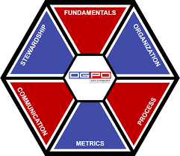
Background
$75 Annually
Value to
Members
Membership
INFM 737 Capstone Project
Notes:
Becky - 30 Seconds
DGPO (Data Governance Professionals Organization) is a non-profit, vendor neutral, association of business, IT and data professionals dedicated to advancing the discipline of data governance.
The DGPO currently charges members around $75 per year for membership, but users find it difficult to navigate the website and search for specific content, making it challenging to access relevant information and understand the value of their membership. DGPO envisions transforming the website into a comprehensive platform where data governance practitioners, both junior and senior, can explore various implementation programs across industries, expand their knowledge, share best practices, and network within the field.

Slide 5
Project Goals
Analyze the current “members only” website content on dgpo.org
What is the existing content structure, depth, and relevance?
Determine gaps in the existing site’s content
What are current resources in the data governance market?
Expand content taxonomies
How can DGPO represent modern data governance standards?
Notes:
Becky - 1 Minute
Analyze the current “members only” website content on dgpo.org in order to understand the existing content's structure, depth, and relevance.
Determine gaps in the existing site’s content by analyzing current resources in the data governance market.
Expand content taxonomies to represent current industry standards, and update the categorization and tagging of content to ensure it reflects modern data governance concepts and standards.

Slide 6
Here’s The Process
Acquire and Research Content
Process and Analyze Content & Survey Results
Determine Content Gaps and Enable Search Functionality
Notes:
Becky - 30 Seconds

Slide 7
Project Milestones
Research Internal and External Resources
Create Expanded Taxonomies
Present Findings
Meet DGPO Team
Discuss Client Needs
Project Charter
Design and Deliver Survey for DGPO Newsletter and LinkedIn
Compile Results
Analyze and Present Gaps in DGPO Content
INFM 737 Capstone Project
Notes:
Becky - 30 Seconds

Slide 8
Deliverables
Notes:
Becky - Now to Turn It Over to Harshitha and Iskander for Deliverables

Slide 9
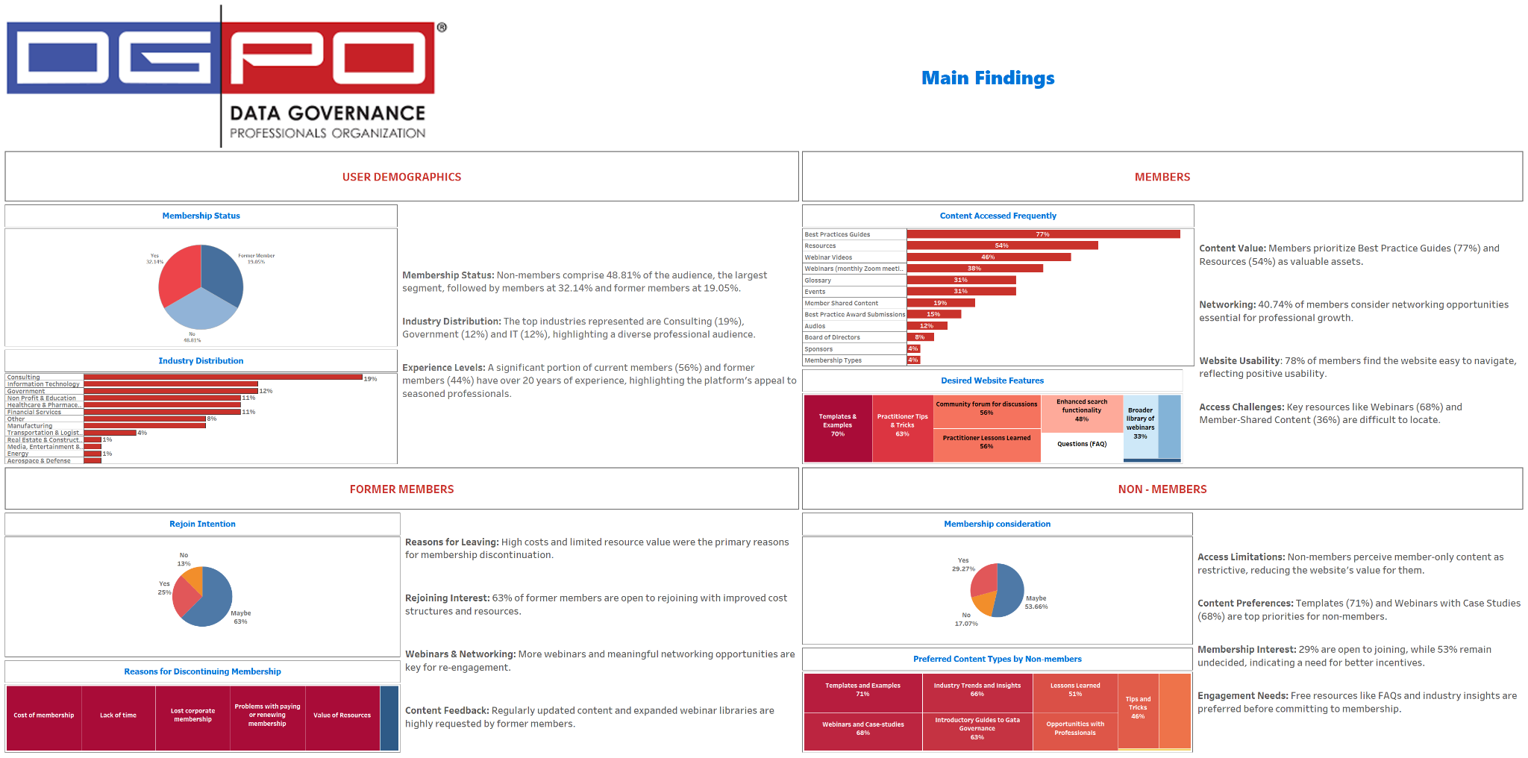
Notes:
Harshitha - 2.5 Minutes
Survey Goals
Improve the Website’s…
usability
content relevance
overall experience to better serve all users

Slide 10
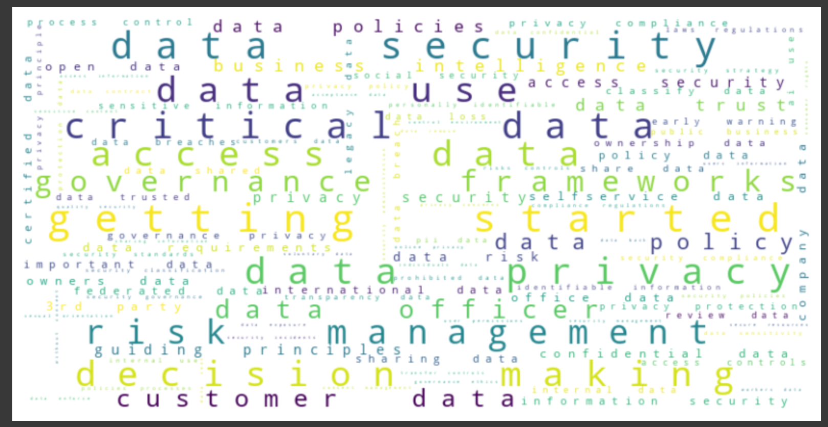
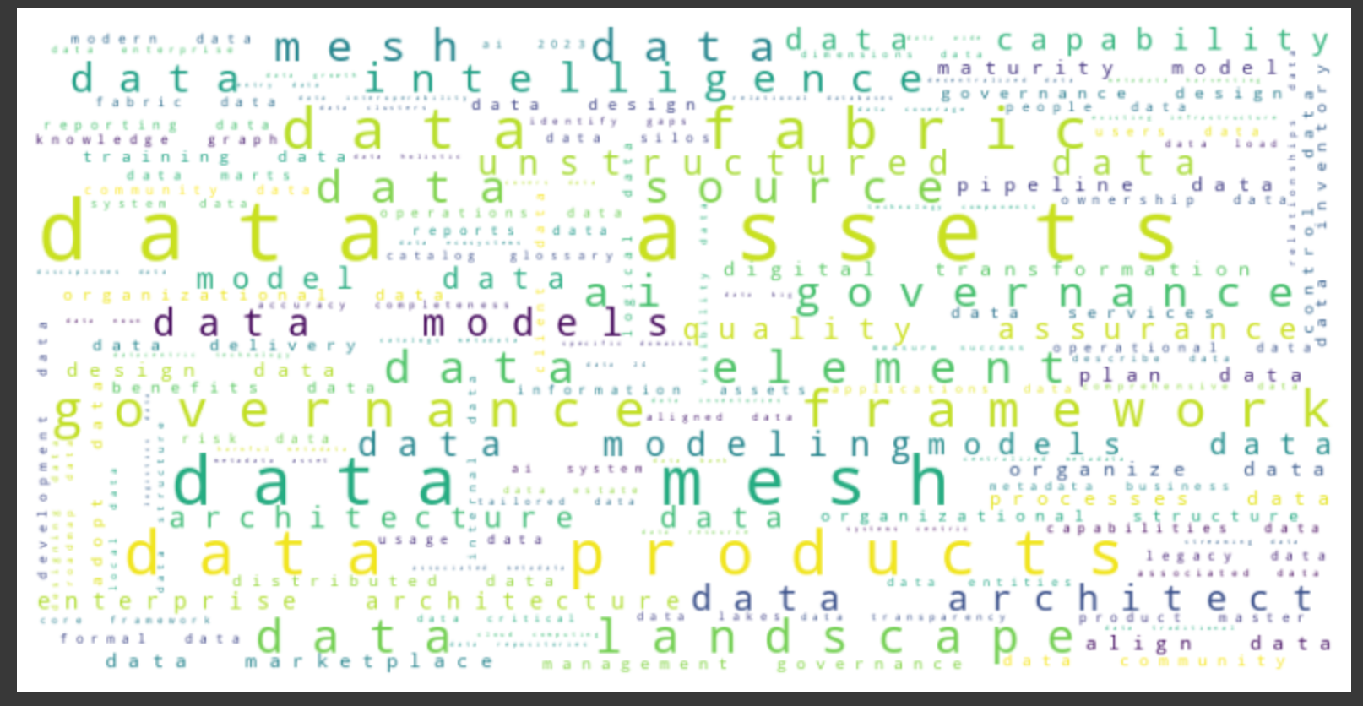
Word Clouds
Bi-Gram Words
Relevant to Data Governance
Notes:
Iskander - 30 Seconds
Bi-Gram Word Clouds Shown: Data Landscape, Data Privacy & Security
Others Available: Data Stewardship, Data Management, Data Quality, Data Strategy, Business Objectives, Data Policy, Compliance, Analytics, User Experience, Industry, Communication, Talent Development, Process, and Organization.

Slide 11
Taxonomy Expanded Based on Internal and External Research
Notes:
Iskander - 1 minute

Slide 12
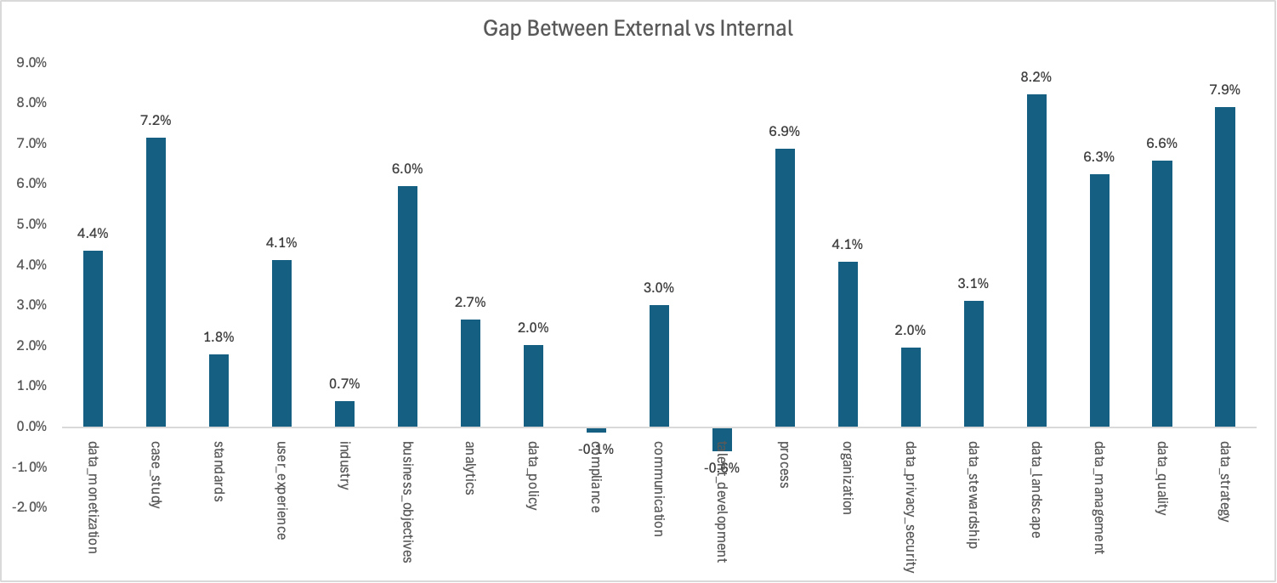
Content Gap Analysis
Gap =
% of External Document - % of Internal Document
For tagging document to a particular taxonomy category, we are matching bigram keywords from taxonomies to documents
At least 10% of keywords from taxonomies should be present in the document for a successful tag
INFM 737 Capstone Project
Notes:
Iskander - 1 minute
At least 3 Bigrams appear in the artifact
Use one as a case example

Slide 13
Recommendations
Match Unigram and Bigram Keywords to Search
Use Taxonomy to Implement Semantic Searching
Diversify Content to Close the Gap Between DGPO and Industry Priorities
Notes:
Sandy - 1 minute
Our recommendations for DGPO

Slide 14
Next Steps
Transfer Ownership of Findings and Recommendations
with Maintenance Steps
Validate Taxonomy
Enable Additional Search Features Utilizing Metadata
Revamp DGPO Website to Include Industry Relevant Content
Based on Gap Analysis
Notes:
Sandy - 1 minute

Slide 15

Thank You!
DGPO & Dataversity
INFM 737 Capstone Project
Notes:
Sandy - We would like to thank DGPO and Dataversity for access to their content for analysis purposes.

Slide 16
Questions?
Notes:
Sandy
We would be happy to take any questions at this time.

